Slide 1
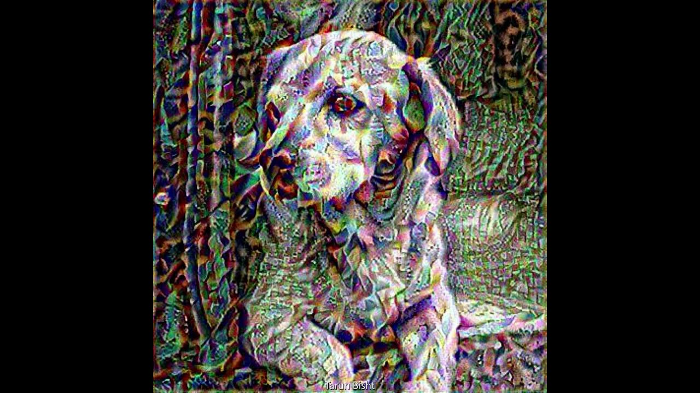
Neural Style Transfer

Slide 2
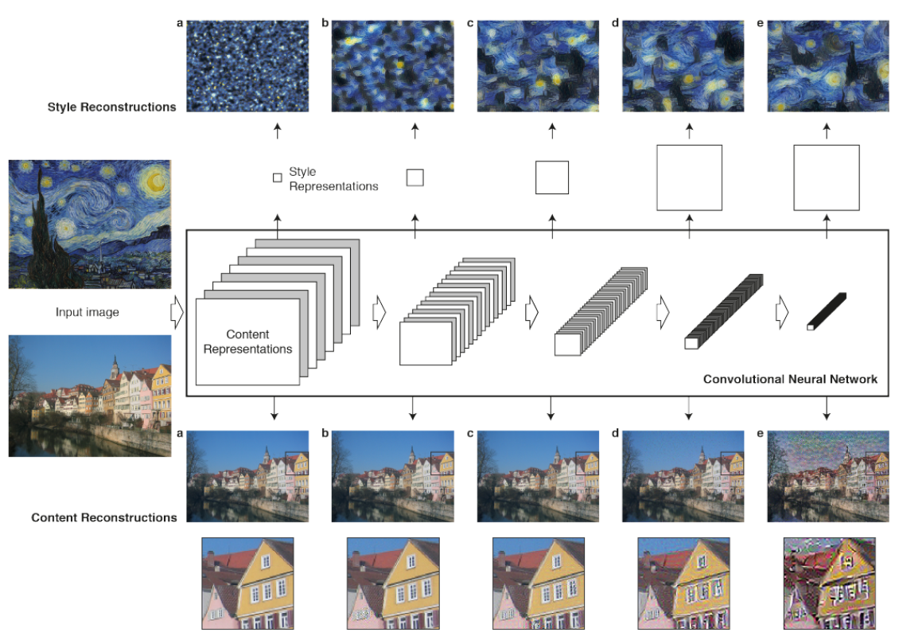
Introduction
Develop an AI tool that:
Transfers artistic styles from one image to another.
Preserves the content of the original while adopting the style (colors, textures) of the reference.
Use Cases: Digital art, photo editing, social media filters.

Slide 3
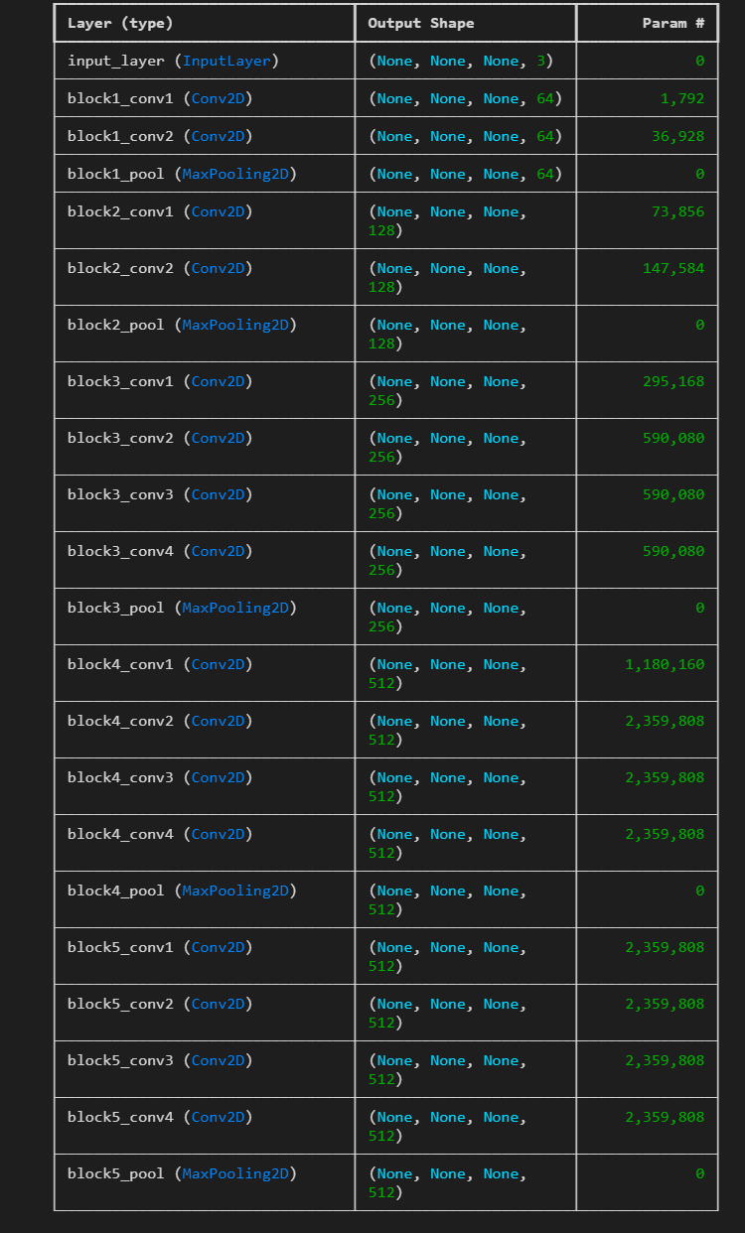
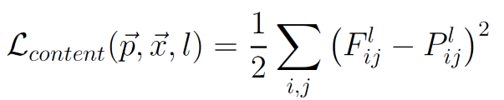
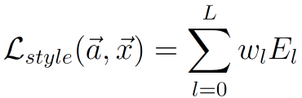
How It Works: VGG19 & Loss Optimization
Feature Extraction: Use VGG19 (pretrained CNN) to extract content/style features from intermediate layers.
a. Content Layer: block5_conv2 (captures high-level structure).
b. Style Layers: block1_conv1, block3_conv1, block5_conv1 (capture textures at different scales).
Loss Functions:
a. Content Loss: Mean squared error between content and generated features.
b. Style Loss: Gram matrix comparison (measures texture correlations).
c. Total Loss: Weighted sum (α*Content + β*Style).
Optimization: Adam optimizer iteratively updates the generated image to minimize total loss.

Slide 4
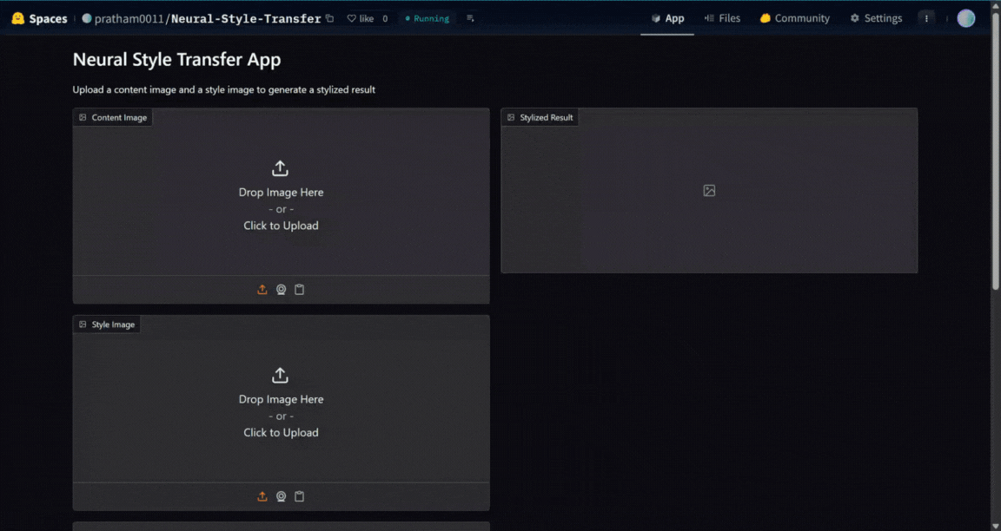
Deployed on Hugging Face Spaces - Link

Slide 5
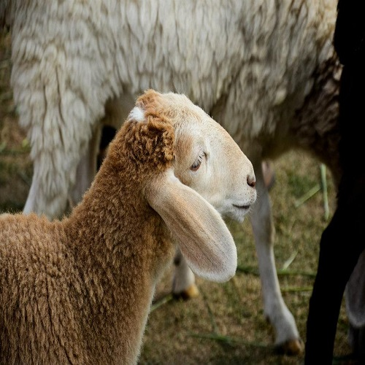
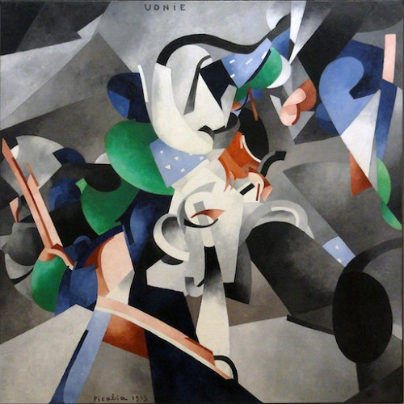
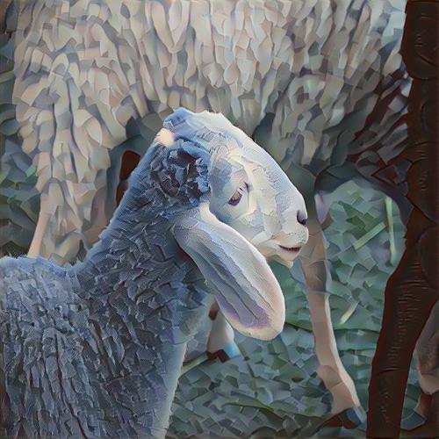
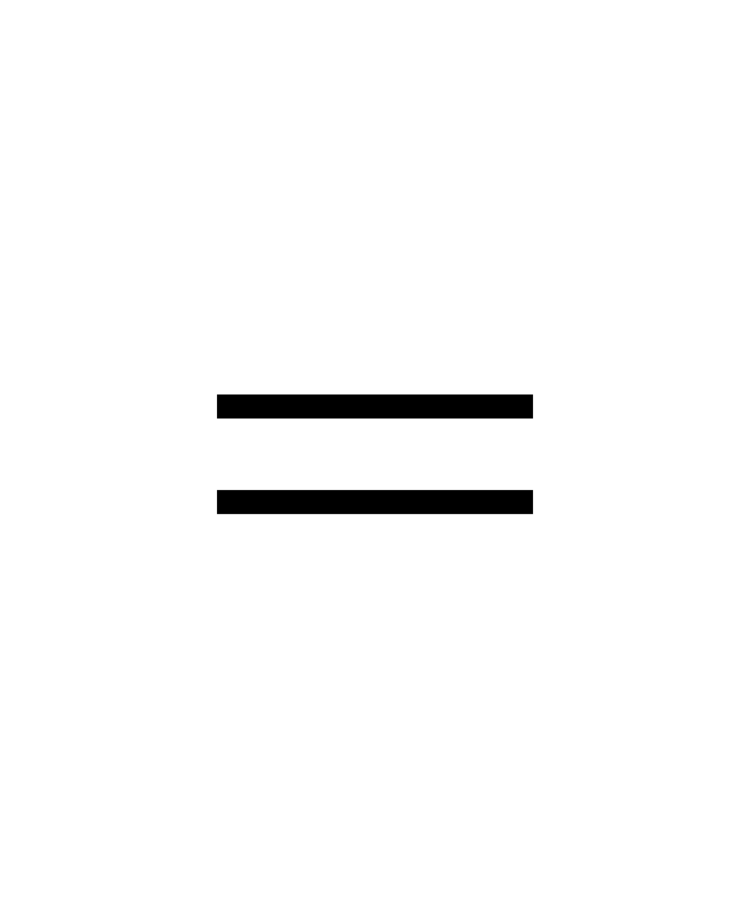
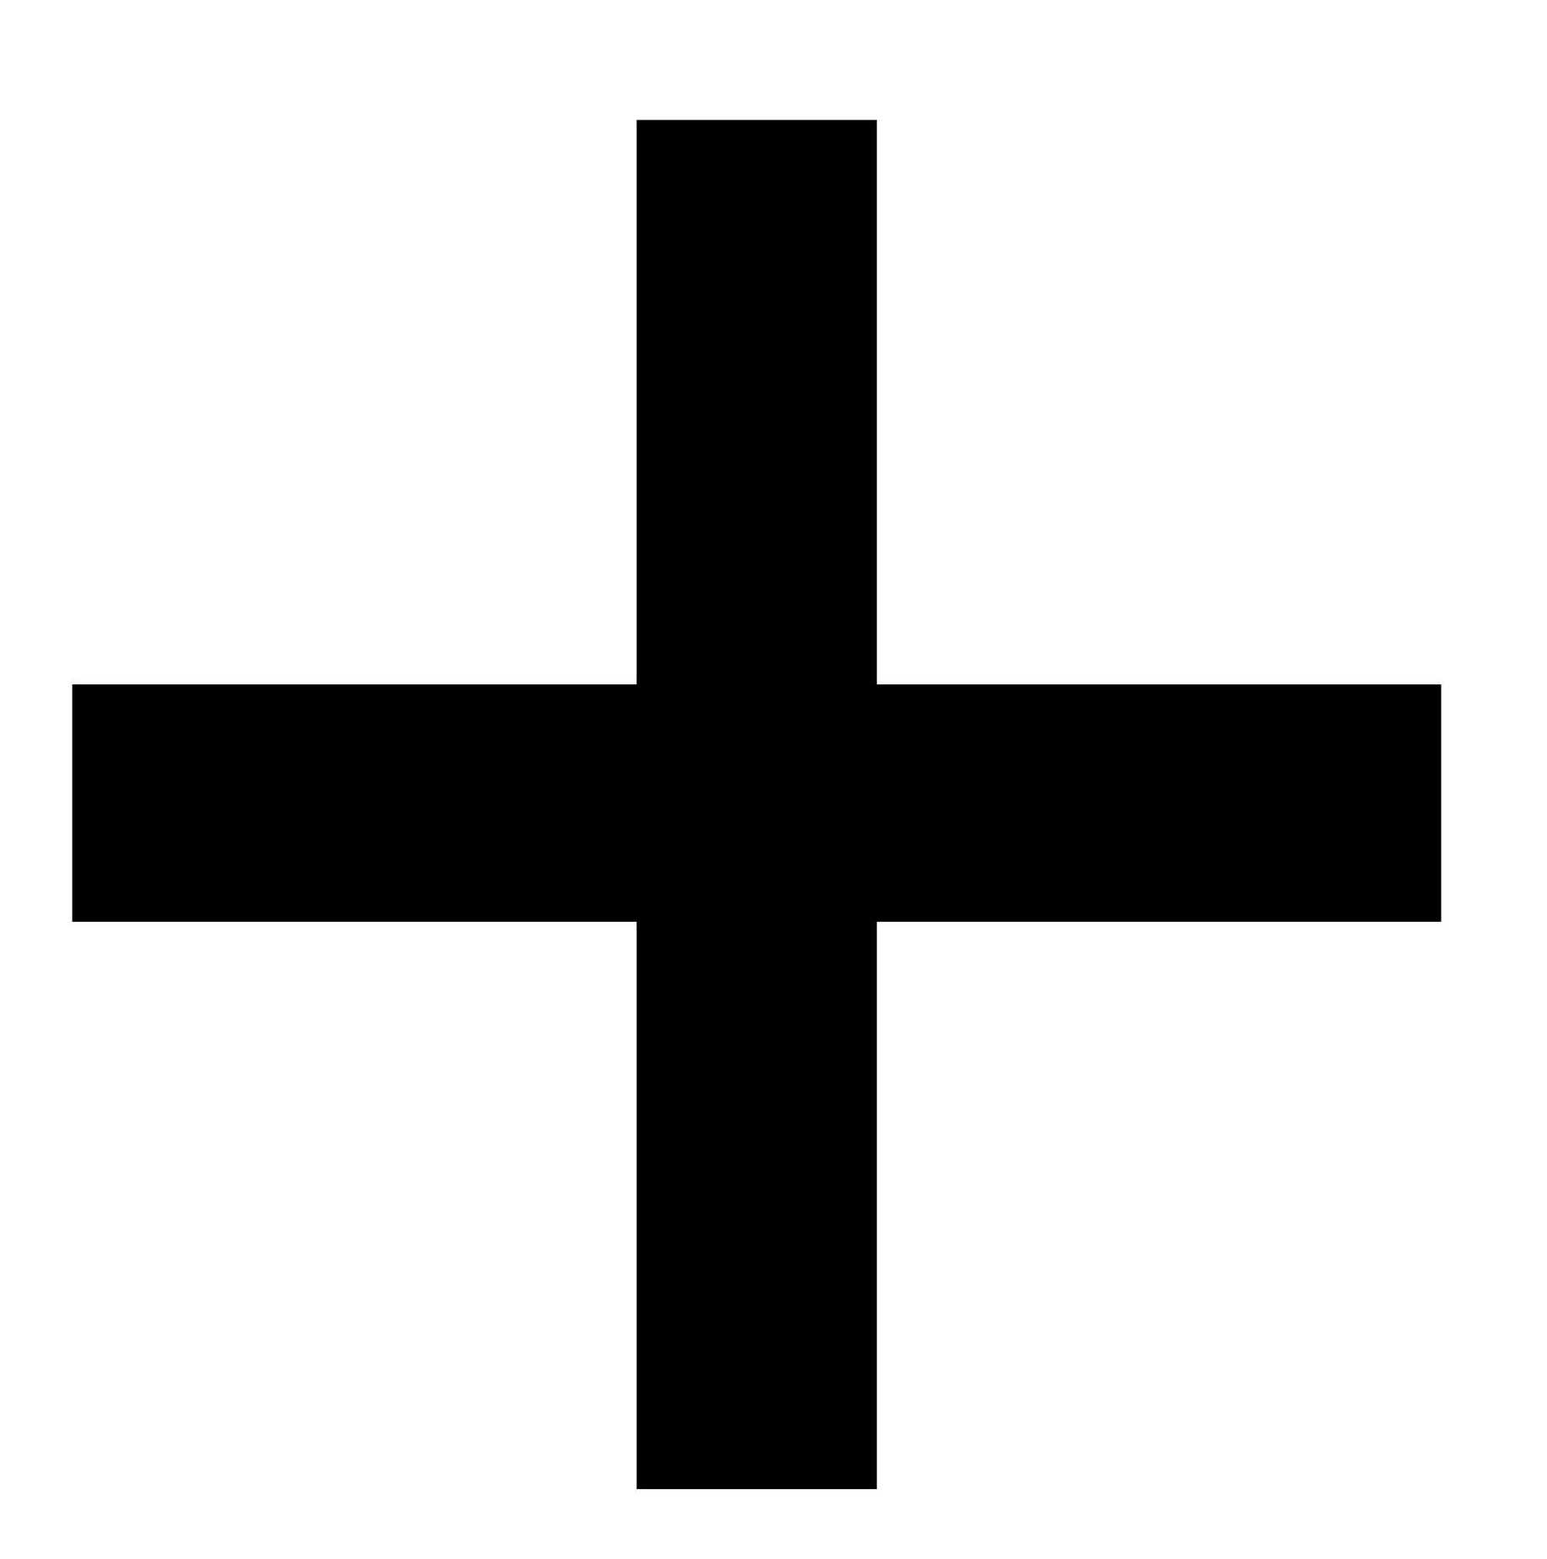
Example Results on GPU

